Slide 1
Secure Data Hiding in Image Using Steganography
CAPSTONE PROJECT
Presented By
Student Name : M THEJA NAICK
College Name & Department : RGUKT SKLM & CSE

Slide 2
OUTLINE
Problem Statement
Technology used
Wow factor
End users
Result
Conclusion
Git-hub Link
Future scope

Slide 3
Problem Statement
The problem of secure data hiding in images using steganography is to embed secret information inside an image without noticeable changes, making it invisible to unauthorized users. Unlike encryption, which makes data unreadable, steganography ensures that the data remains hidden while appearing like a normal image. The main challenge is to balance security, image quality and robustness so that the hidden data is not easily detected or removed. The goal is to develop an efficient method that allows safe embedding and extraction of data while maintaining the original image's appearance.

Slide 4
Technology used
Programming Language:
Python– For implementing steganography algorithms.
Libraries & Tools:
OpenCV(cv2)– For reading, modifying, and saving images.
Steganography Technique Used:
LSB (Least Significant Bit) Steganography– Hides data by modifying the least significant bit of pixel values.
Platforms:
Jupyter Notebook / Google Colab– Can be used for testing and debugging.

Slide 5
Wow factors
Dual-Layer Security (Steganography + Password) – Prevents unauthorized access by requiring a password for decryption.
Invisible Data Hiding – Uses LSB steganography to embed messages without noticeable changes in the image.
No File Size Increase – Unlike traditional encryption, this method hides data without significantly altering the image size.
Cross-Platform & Multi-Format Support – Works on Windows/Linux/macOS and supports JPG, PNG, BMP formats.
Optimized Pixel Encoding – Efficiently distributes data across RGB channels, reducing detection risk and maintaining image quality.

Slide 6
End users
Cybersecurity Professionals – Use it to securely share confidential information without detection.
Journalists & Whistleblowers – Hide sensitive messages in images to protect identity and avoid surveillance.
Military & Intelligence Agencies – Securely communicate covert messages in high-security environments.
Forensic Experts & Law Enforcement – Conceal crucial evidence or track digital forgeries without alerting suspects.
Everyday Users & Privacy Enthusiasts – Protect personal data, passwords, or private messages from cyber threats.

Slide 7
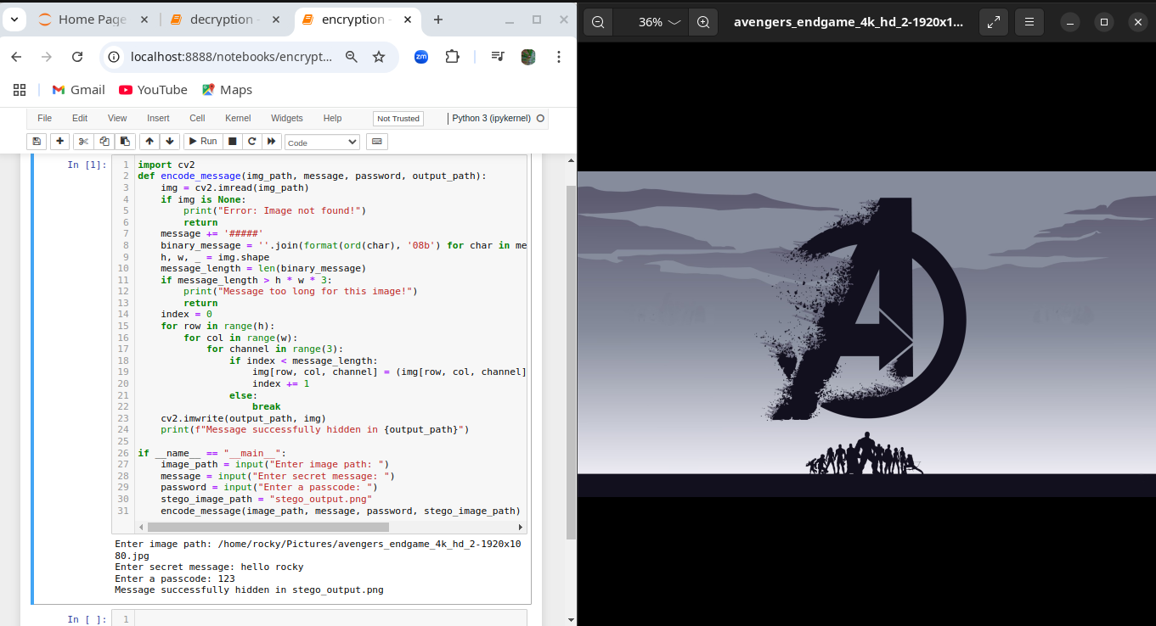
Results
Encryption process

Slide 8
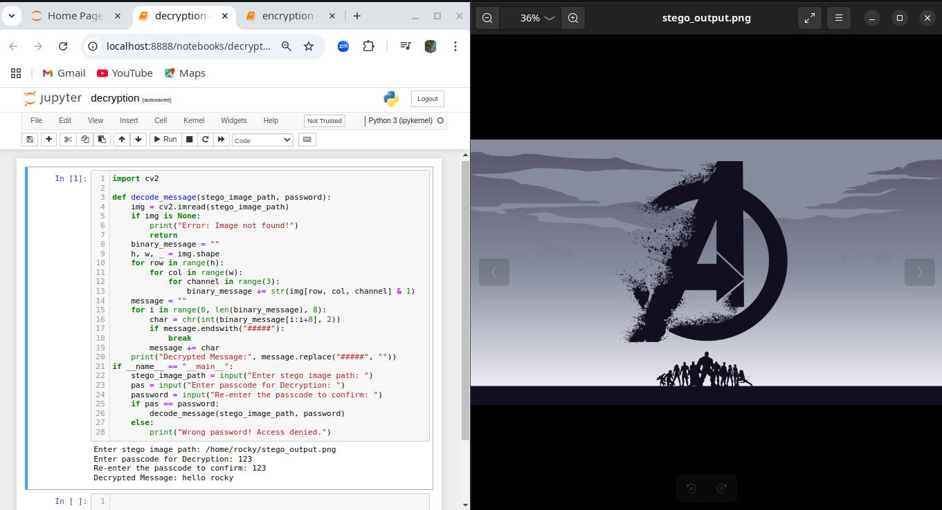
Results
Decryption process

Slide 9
Conclusion
This project successfully implements secure data hiding using LSB steganography, addressing the need for confidential communication without drawing attention. By embedding messages within images while preserving quality, it ensures invisibility and security. The password-protected decryption adds an extra layer of protection, making it useful for cybersecurity, intelligence, and personal privacy

Slide 10
GitHub Link
Github Link - https://github.com/Rockydirector/THEJANAICK.git

Slide 11
Future scope(optional)
Integration with AES/RSA Encryption – Enhancing security by encrypting the hidden message before embedding it into the image.
AI-Powered Steganalysis Resistance – Developing techniques to bypass AI-based steganalysis tools used for detecting hidden data.
Cloud & Blockchain-Based Secure Storage – Storing steganographic images on cloud platforms or blockchain for tamper-proof security.
Steganography in Video & Audio Files – Expanding beyond images to videos, audio, and PDFs for broader applications.
Mobile & Web App Development – Creating a user-friendly mobile or web-based tool for secure steganographic communication.

Slide 12
THANK YOU

